Slide 1


CAO MEMBERS IN TRANSITION TOOLKIT
“Experiencing transition has made me a better person and a better CAO.”

Slide 2

CAO MEMBERS IN TRANSITION TOOLKIT
The landscape of transitioned CAOs throughout Canada continues to grow.
Toolkit developed based on personal experiences.
Advice on Pre-Transition, During Transition, and Post Transition
Input from 16 CAMA members.
Thank you Companions!

Slide 3
THANK YOU TO STEERING COMMITTEE
Tony Kulbisky, CAO, Town of Devon, AB / Chair – Board Representative for Alberta
Jeff Renaud, CAO, Town of St. Stephen, NB / First Vice-President – Member At Large
Jake Rudolph, CAO, City of Nanaimo, BC / Second Vice-President / Board Representative for British Columbia
Rodney Cumby, City Manager, City of Cornerbrook, NL / CAMA Member
Jennifer Goodine, CAMA Executive Director
Susan Shannon, Principal, muniSERV/muniJOBS - Consultant

Slide 5


Slide 6
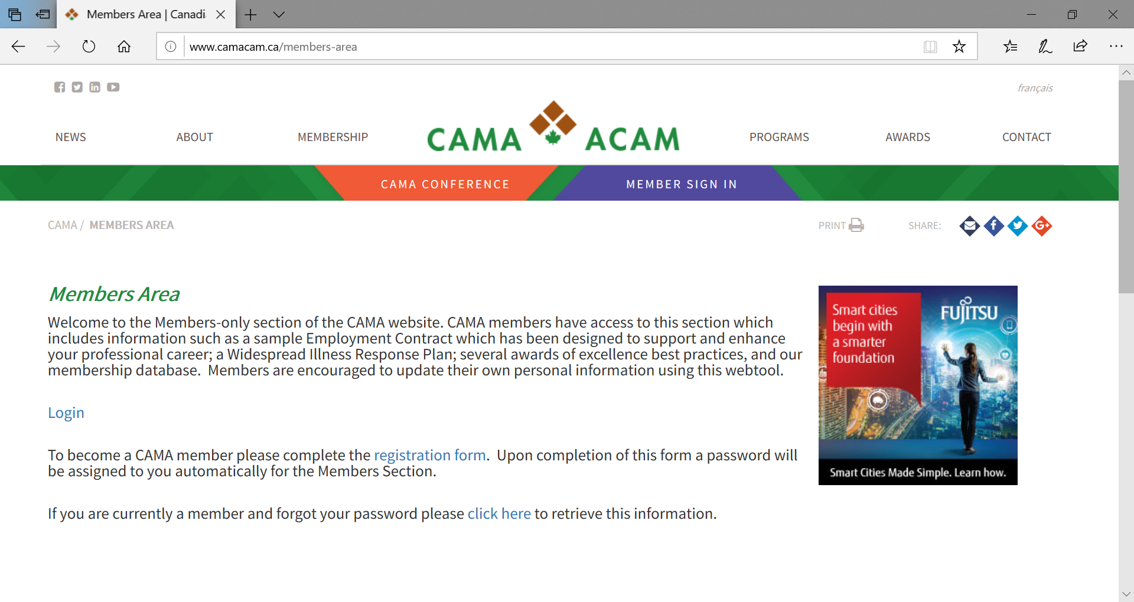

Slide 7
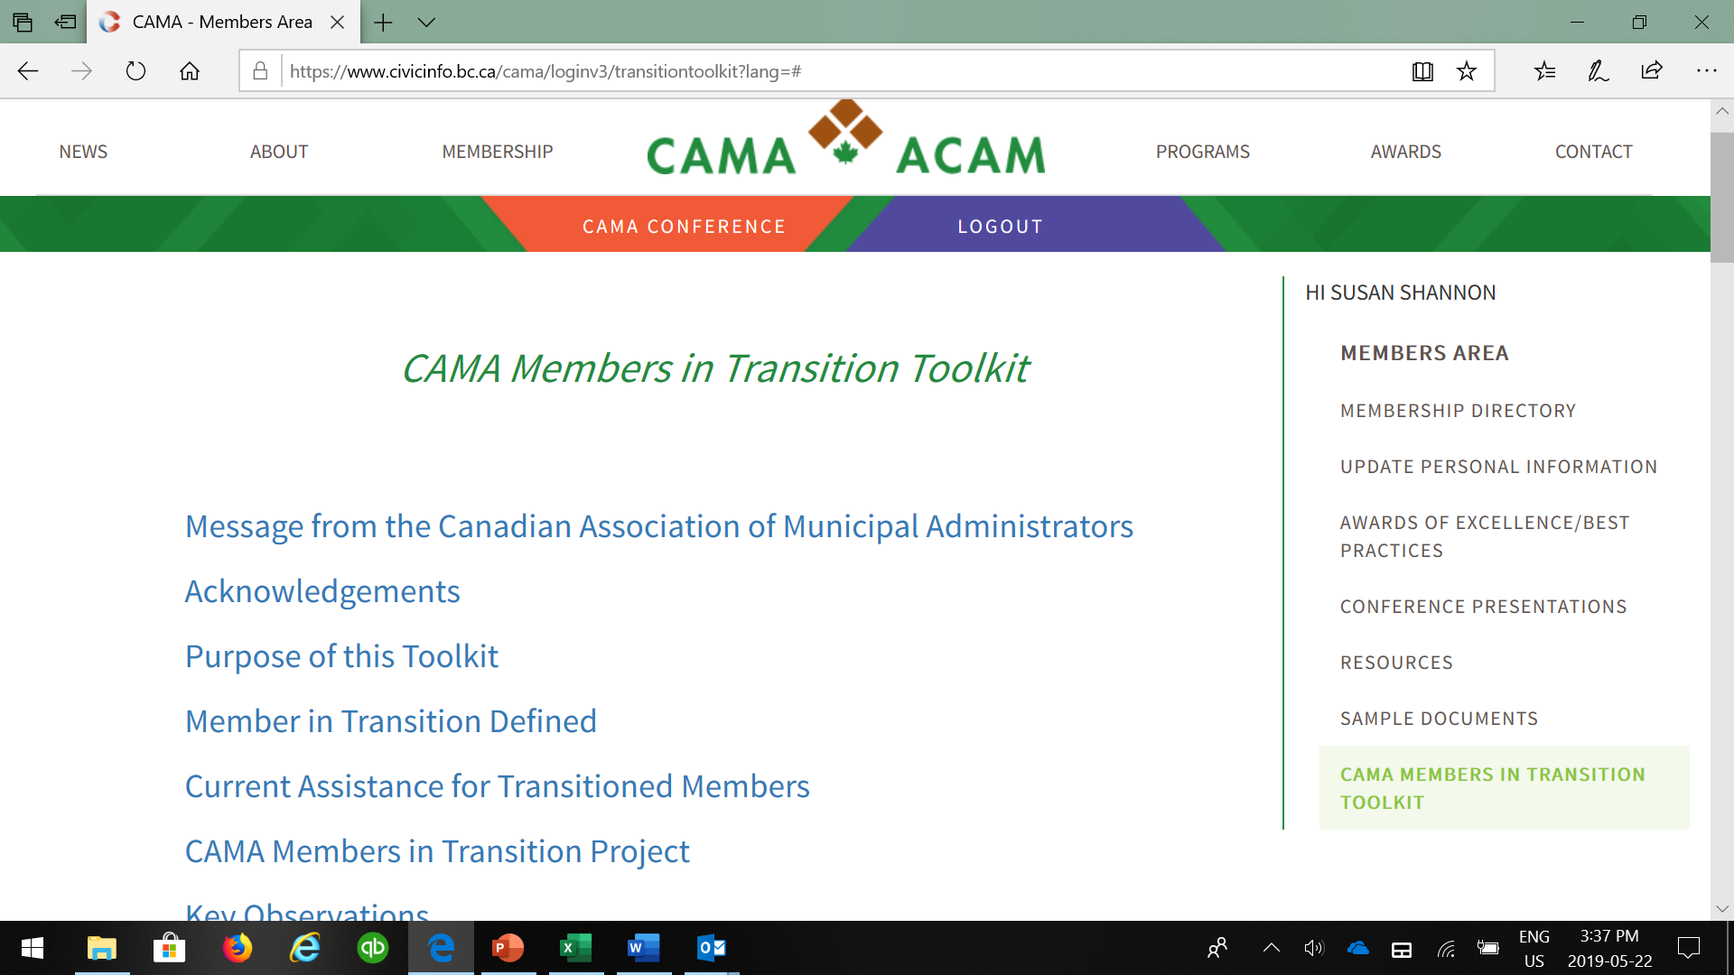

Slide 8
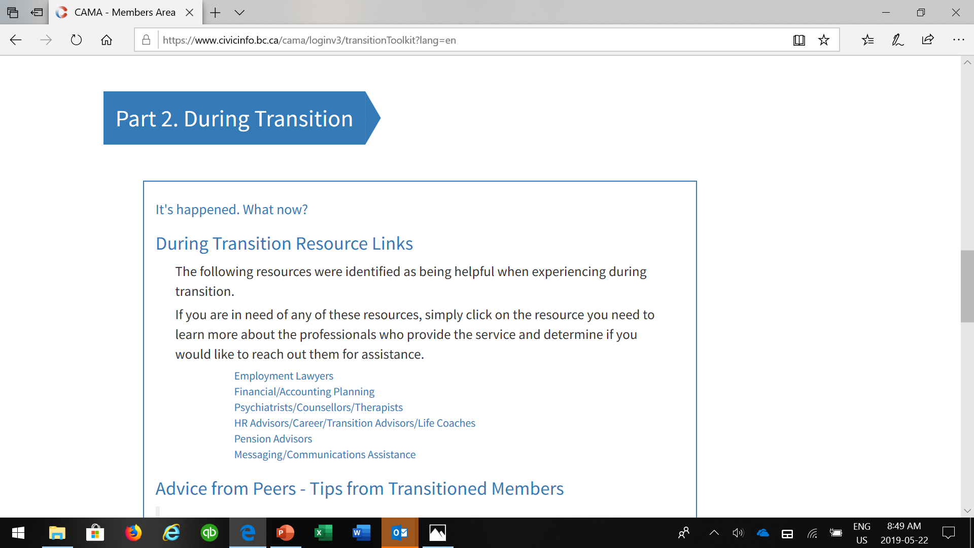

Slide 9
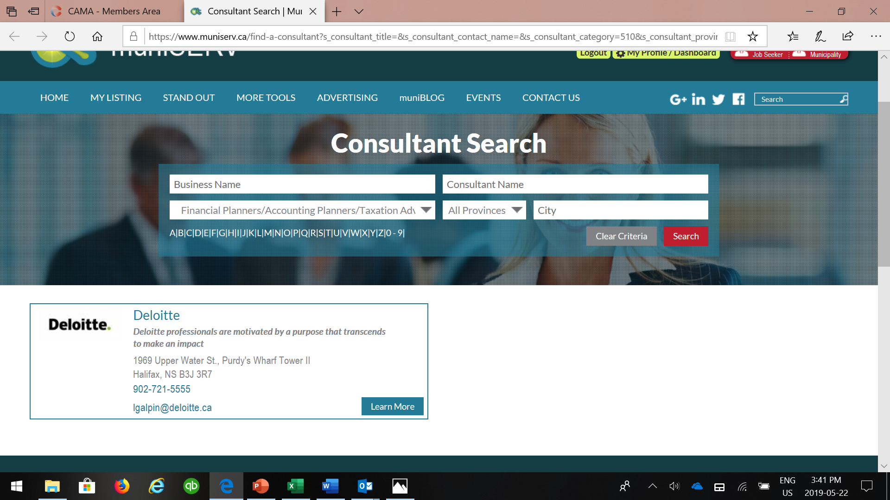

Slide 10


Slide 11
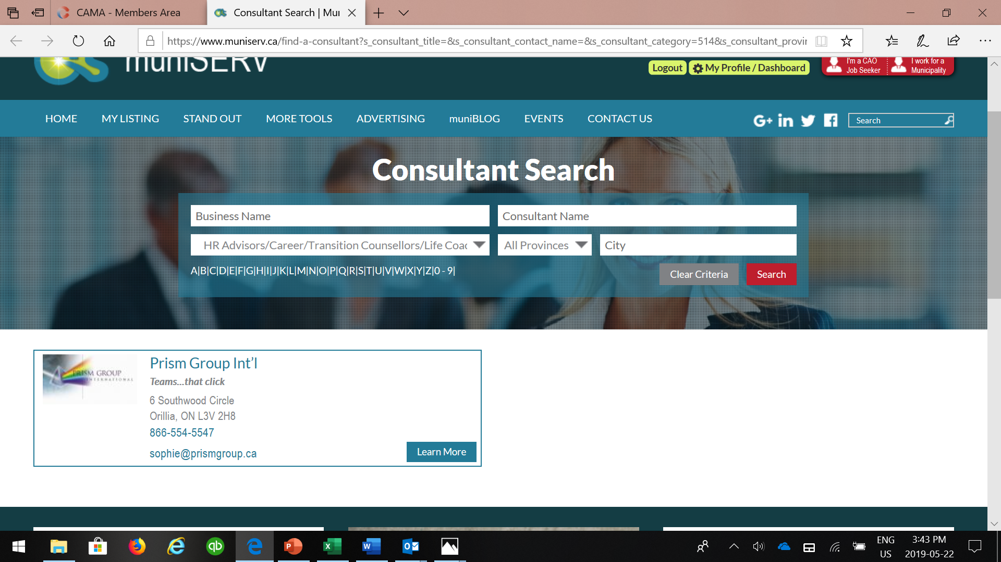
Notes:
Show how to click on the Resources sections
How it takes them to CAMA resources and
How the links take them to muniSERV.ca and appropriate categories.

Slide 12
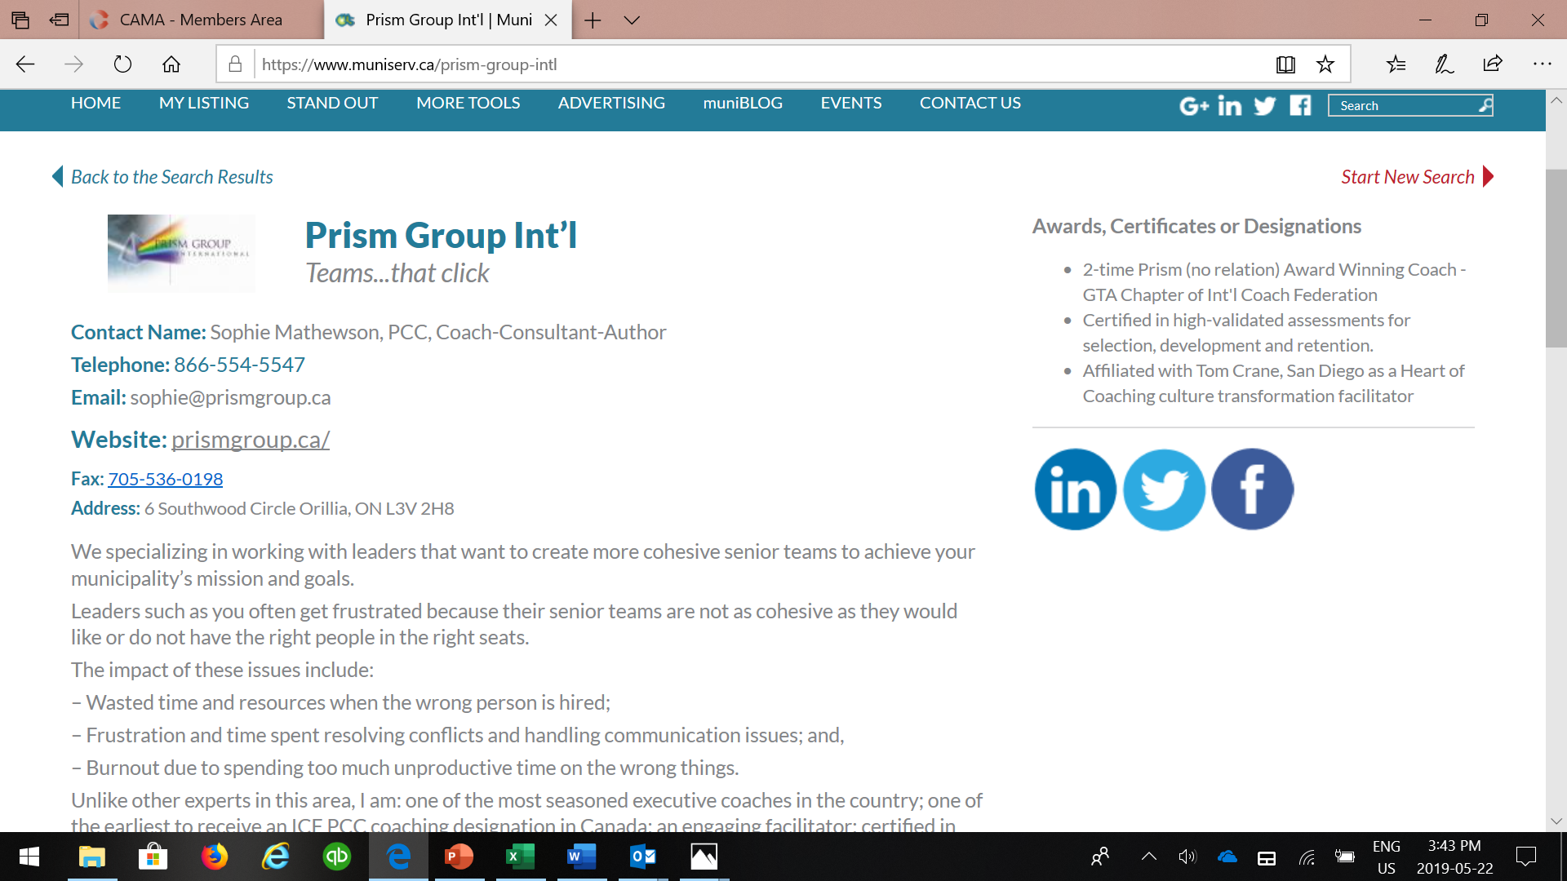
Notes:
Show how to click on the Resources sections
How it takes them to CAMA resources and
How the links take them to muniSERV.ca and appropriate categories.

Slide 13
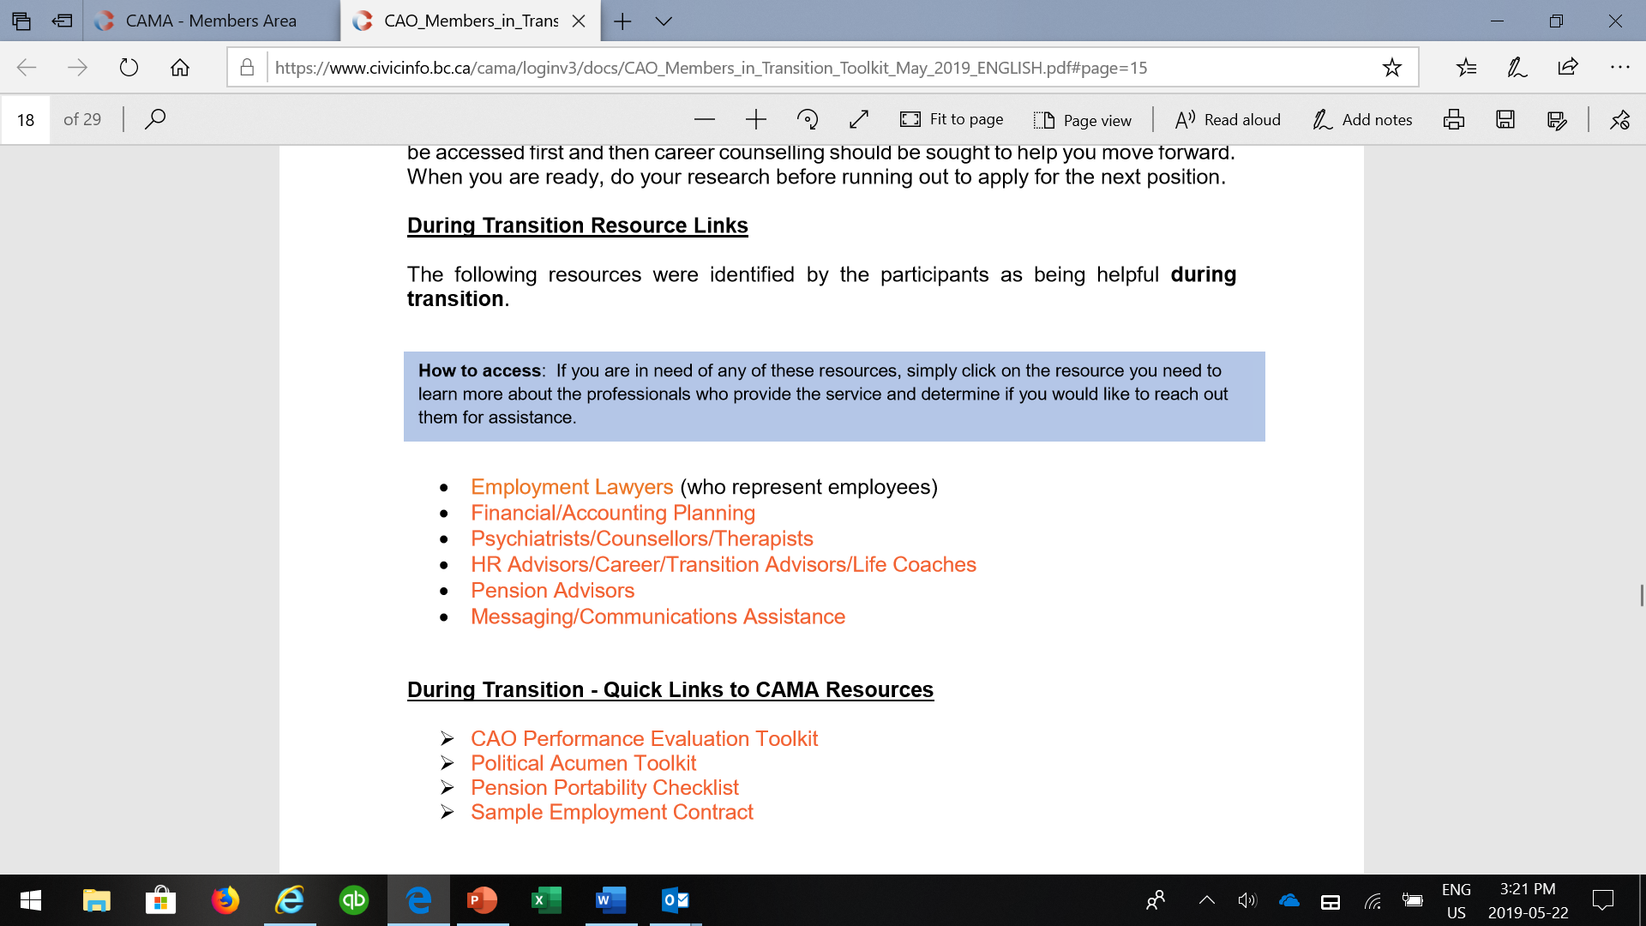

Slide 14
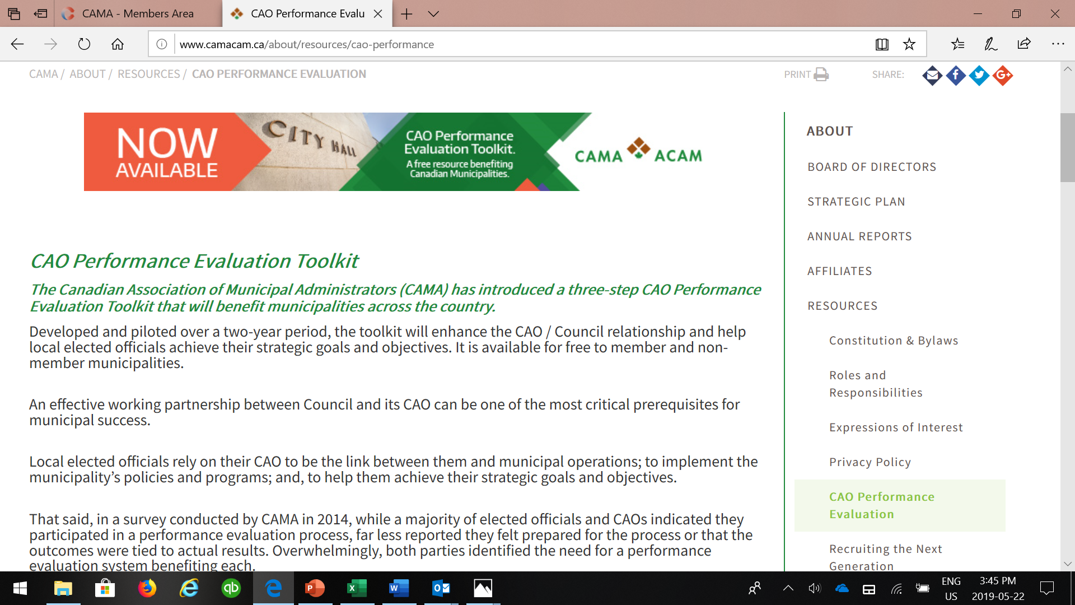

Slide 15
