Slide 1


Creating a Positive Environment for Employees with Mental Health Issues
CAMA Conference
Quebec City May 28, 2019

Slide 2

Overview
Introduction
Implications of Stigma
How to provide a supportive workplace
Review “The Working Mind”
Next steps
Questions?

Slide 3
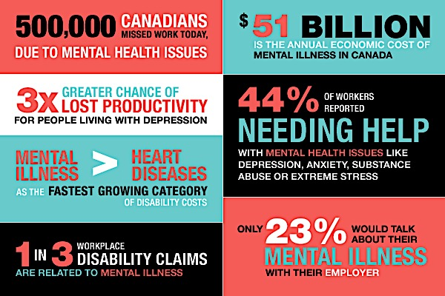
Workplace Costs
Source: Wordpress.com
Notes:
Here are some different ways at looking at the cost

Slide 4


Creating a Mentally Health Workplace: ROI
ROI
Notes:
Employers who implement effective programs to create a mentally healthy workplace can expect a positive return on investment (ROI) of 2.3.

Slide 6



Workplace
Survey
Workplace stress a leading cause of mental health issues
Depression and anxiety top two mental health issues
49% of Canadians suffer from mental illness at some point
Notes:
1575 employees surveyed
A third of Canadians cite workplace stress as primary cause of their mental illness
Three quarters say their mental health problem has already affected or would have an impact on their careers
66 per cent say employers don’t have any anti-stigma programs or policies
75 per cent not aware of an overall mental health strategy

Slide 7


Introduction - Laying the Groundwork
World Health
Organization
The Conference
Board of Canada
Notes:
Both the WHO and International Labour Organization are on the record identifying mental health issues legitimate “work-related concern”
Employers and managers need to:
Understand disability legislation and need to make accommodations
Develop policies and programs
Provide access to services i.e. EAP
Provide education and training

Slide 8


Slide 9
Why reduce the stigma of
mental Illness?

Slide 10
The Importance of
Stigma Reduction
Earlier help-seeking
Better prognosis & outcome
More acceptance of MH;
More supportive environment
Reducing Stigma
Cultural shift in thinking and attitudes
Positive outcomes
for those with mental illnesses
Increase productivity
Positive financial impact
Notes:
-analogy…stigma is a threshold concept that opens the door for other things

Slide 11

Stigma
Discrimination
Prejudice

Slide 12
How to reduce stigma?
Discrimination:
Creating: Laws, Rules, Policies
Enforcing i.e. holding people accountable for their actions
Prejudice:
Training
Supportive work culture
Enforcing i.e. holding people accountable for their actions
eating: Laws, Rules, Policies

Slide 13
Supportive Culture
Sound disability and accommodation principles
Comprehensive benefits
Effective education and training
Strategic & integrated policies and programs

Slide 14
13 Psychological Factors
Psychological Health & Safety Standards
Psychological and Social Support
Organizational Culture
Clear Leadership and Expectations
Civility and Respect
Psychological Competencies and Requirements
Growth and Development
Technology
Accountability
Involvement and Influence
Recognition and Reward
Workload Management
Engagement
Balance
Psychological Protection
Technology
Protection of Physical Safety
Source: Guarding Minds at Work
Notes:
National Standard of Canada for Psychological Health & Safety in the Workplace: Employment Policies, Job Design & Management Systems To learn more about the National Standard of Canada for Psychological Health and Safety in the Workplace, visit: https://www.mentalhealthcommission.ca/English/national-standard To learn more about implementing the National Standard, visit: https://www.mentalhealthcommission.ca/English/implementing-standard The National Standard has 13 factors that affect psychological health and safety in the workplace. Of 69 subfactors, the following relate to employment policy, job design, & management systems: • Job expectations are clear • Organization reviews management accountability for performance • Worker receive feedback to help them grow and develop • Supervisor interested in worker feedback on opportunities & challenges • Supervisor shows appreciation for worker contribution • Worker talks to supervisor about how work is done • Workload is reasonable & worker can talk to supervisor about workload • All employees held accountable for their actions • All employees show sincere respect for other ideas, values, beliefs • Difficult situations and conflicts are addressed effectively • There is trust between workers and management • Organization has a process when employee looks distressed • Organization has supportive RTW protocol for mental health condition • Organization handles conflict between workers at all levels • Organization values workers’ ongoing growth and development • Organization appreciates worker effort, commitment & passion • Organization promotes work-life harmony Healthy and safe workplace will have the following: • Effective management systems that are implemented and regularly assessed: o Job design: Current/accurate job descriptions that reflect skill, effort, degree of responsibility (impact) and working conditions of the job as intended and performed with identified essential duties o Oversight: Management training with best practice tools to manage effectively, appropriately, and humanely o Assessment: Performance management system with regular/appropriate feedback and helpful support (OPS model – ask how best to provide feedback) • Effective policy framework that is implemented and regularly assessed: o Mission/Vision/Goals that reference employee success o Workplace Code of Conduct policy o Workplace Harassment, Discrimination, & Violence policy and procedure o Workplace Accommodation & Return to Work policy and procedure o Workplace Performance Appraisal policy and procedure with employee feedback

Slide 15
National Standard of Canada for Psychological Health and Safety in the Workplace
Voluntary guidelines intended to guide organizations in promoting mental health and preventing psychological harm at work
Launched in January 2013
Adopting the Standard can help organizations with:
  Productivity
  Financial Performance
  Risk Management
  Organizational Recruitment
  Employee Retention

Slide 16
Implementation of the Standards
Employers who comply with the Standard will:
take measures to prevent and protect workers from psychological harm;
provide training and education to promote psychological health and safety;
involve a diversity of workers in identifying problems and solutions;
develop a clear process for reporting, investigation, and monitoring psychological health and safety concerns;
be encouraged to conduct regular internal audits; and
collect data and develop a plan to control risks related to the 13 factors affecting psychological health and safety in the workplace.

Slide 17
Focus on all Levels of
Mental Health Support
Prevention
Intervention
Recovery & RTW
Focused on reducing impact of poor mental health :
Hazard Assessment
Policy integration
Triage
Supportive benefits
Disability Management
Fit for Duty
Stay at Work
External Referral
Aimed at ensuring
early and safe return to
work:
Policy integration
Case management
Disability Management
Return to Work program
Accommodation
Support strategies to prevent re-injury
Supportive benefits
Aimed at promoting good mental health:
Supportive culture
Coaching
Wellness programs
Mentoring
Policy integration

Slide 18
People Leader’s Role in Managing
Workplace Mental Health Issues
Support Organizational Culture
Support individual employees
Facilitate Early and Safe Return to Work
Assess Accommodation
Issues
Maximize
Employee
Productivity

Slide 19

  The Working Mind
  Workplace Mental Health & Wellness
By the Mental Health Commission of Canada
Adapted from the Department of National Defence’s and the Canadian Forces’ Mental Health First Aid in the Workplace: Mental Health Training for Managing Employees and Road to Mental Readiness programs
Presented by:
Name, Title
September 2013
Notes:
Objectives:
- Reduce the stigma of mental illness
Promote mental health in the workplace
Reconceptualize how people think and talk about mental health and mental illness
Help people identify poor mental health in themselves and others
Teach coping skills to manage stress and poor mental health, and increase resiliency
Create a more supportive environment for all
Elements or tools – Contact based education, Big 4, Mental Health Continuum

Slide 20

TWM: Objectives
Reduce the stigma of mental illness
Promote mental health in the workplace
Reconceptualize how people think and talk about mental health and mental illness
Help people identify poor mental health in themselves and others
Teach coping skills to manage stress and poor mental health, and increase resiliency
Create a more supportive environment for all

Slide 21
TWM:
Main Components
Education-based program:
Anti-stigma module and evidence-based content
- Video-based contact, myth busting, facts, etc.
“Big 4” skills (SMART goal setting, mental rehearsal, positive self-talk, diaphragmatic breathing)
Mental Health Continuum Model

Slide 22

Physical Injury/Illness
INCIDENT
Injury
Diagnoses
Treatment
Return to Work
Mental Injury/Illness
Time
Wang PS, Berglund P, Olfson M, Pincus HA, Wells KB, Kessler RC. Failure and delay in initial treatment contact after first onset of mental disorders in the National Comorbidity Survey Replication. Arch Gen Psychiatry, June 2005;62(2):603-1
Notes:
22
22
Delay among those who eventually make treatment contact ranges from 6 to 8 years for mood disorders and 9 to 23 years for anxiety disorders.

Slide 23
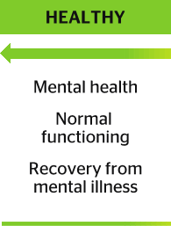
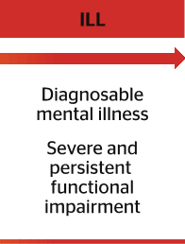
Notes:
This is the way we used to look at mental illness if someone became sick they often went off and never came back to work

Slide 24
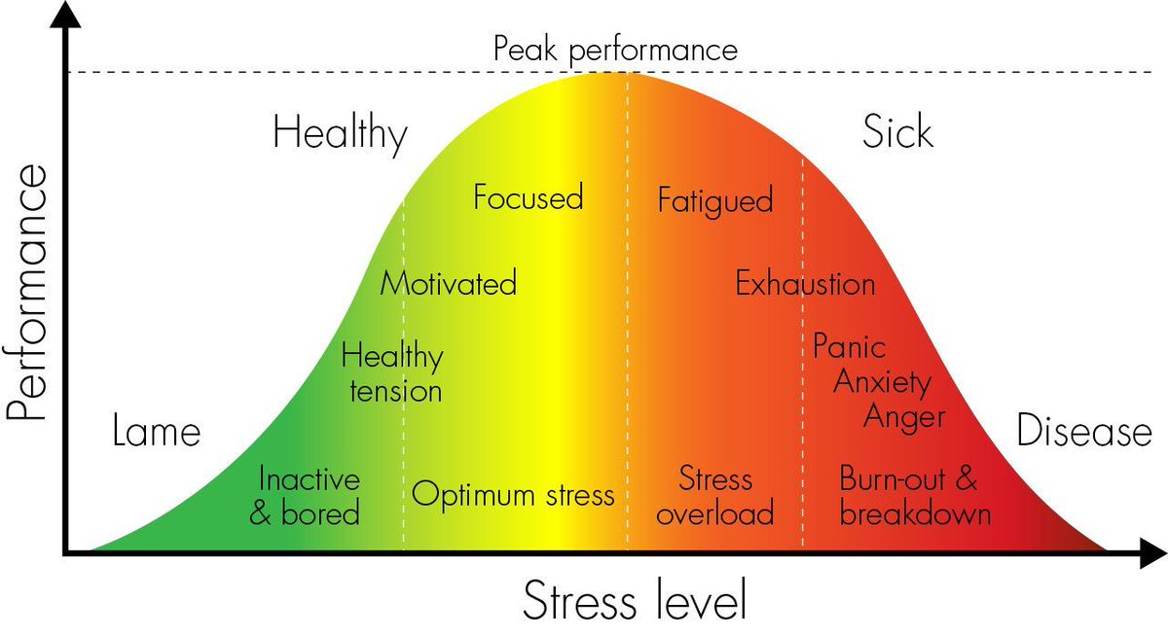
Inactive
Bored

Slide 25
Mental Health Continuum Model
Notes:
-The MHCM is the essence of the program.
-another way of conceptualizing mental health and illness
- It is simple and intuitive

Slide 26

The Big Four
The Big Four must be practiced regularly to be effective.
    Goal Setting
    Visualization
    Self-talk
    Deep Breathing
Notes:
After we have identified where we may be on the continuum, we offer skills to help people move back and forth
The “Big Four” refers to the practical skills component of the Road to Mental Readiness Program. These skills are being taught to “train the brain” and like any skill, they must be taught, mentored and practiced regularly in order to be effective. The purpose of the Big 4 is to:
Help one deal with and manage the stressors one encounters on a daily basis
Increase resiliency (ability to bounce back) and ability to thrive under pressure
Increase performance
A brief overview:
Goal Setting – Goal setting can help motivate as well as provide direction. Writing goals down and talking about them increases the likelihood of success.
Visualization – This is used to rehearse situations and strategies – to anticipate events and prepare for the challenges ahead.
Self-Talk – We continuously talk to ourselves. If these words are negative rather than positive, it greatly undermines our ability to be successful. The key to self-talk is to make the messages positive rather than negative.
Tactical Breathing – Tactical breathing is based on the observation that many people breathe shallowly or irregularly when anxious or tense – which can actually cause the physiological symptoms of anxiety. Tactical breathing will help reduce anxiety, and the benefits can be seen right away. This technique needs to be practiced so that people can master the technique.

Slide 27
Boosters | Self led online tools
Mental Health Continuum Model
Stigma in the Workplace
Goal Setting
Visualization
Deep/Diaphragmatic Breathing
Self Talk

Slide 28
Evaluation Results
Pre-workshop
survey
MR
Post-workshop survey
3 and 6 months
Quantitative Results
Sig. ↓ in stigmatizing attitudes in managers, sig. ↓ in employees (pre to post) (majority of gains retained at 3 month follow-up)
Significant ↑ in resiliency skills (i.e., perceptions of ability to be resilient) (pre to post)
Significant ↑ in overall resiliency and mental health and wellbeing (pre to 3 month follow-up)
Notes:
28

Slide 29
Preliminary Evaluation Results
Evaluation Results
Qualitative Results for TWM
Reduced stigma; more aware & understanding:
“I liked that the workshop dispelled myths & common misconceptions”
“An eye-opening experience”
Practical skills; more equipped to address MH:
“How to identify continuum in personal life”
“Relevant to real life work and personal situations”
Workshops well received:
Excellent videos of people with lived experience
Interactive
Well presented, interesting, engaging, enjoyable

Slide 30
Training Options
5 day Train-the-Trainer workshop which permits organizations to provide their own training on an ongoing basis
Half day primary/basic workshop for staff
Full day leadership workshop for supervisors and managers (includes primary course)
  Leaders learn to address employee mental health at each stage along the MHCM and manage accommodation
  *(Maximum class size 25 participants)
Notes:
- Employee version contains anti-stigma component, MHCM, big 4, videos, etc.
- We feel Training managers is an essential component to shifting workplace culture to one that is supportive of mental health and reduces stigma and discrimination
30

Slide 31




















TWM Clients
Notes:
Last 4 years we have trained more than 25-thousand people
Last year close to 42-hundred
2 provinces
2 major Health Authorities
Late this fall contract to train entire federal Public Service through HC – 270-thousand
Starting to see more private sector uptake

Slide 32
Community Partnerships
Develop and foster partnerships with:
  Health Care Providers
  Employee and Family Assistance Programs
  Treatment programs
  Independent assessors
  Family Support System

Slide 33
Your Approach
Gap Analysis
Appreciate your resources
Build Partnerships
Which model can you support: functional vs medical?
Plan for the future

Slide 34

Questions? Comments?

Slide 35

Thank you
Contact us:theworkingmind@mentalhealthcommission.ca
Visit: www.theworkingmind.ca
Follow us:

