Slide 1
positive and respectful workplaces
presented by Lauren Bernardi

Slide 2
overview
why respect matters
sources of harassment
impact
creating a positive and respectful workplace
Notes:
LB - United Airlines
Roy - plan A & plan B

Slide 3
psychologically safe workplaces

Slide 4
psychosocial factors
Psychosocial Support
Organizational Culture
Clear Leadership and Expectations
Civility and Respect
Psychosocial Competencies and Requirements
Growth and Development
Recognition and Reward
Involvement and Influence
Workload Management
Engagement
Balance
Psychological Protection
Protection of Physical Safety

Slide 5
organizational factors
Organizational culture
Clear leadership and expectations
Engagement
Psychological protection
Protection of physical safety

Slide 6
job related factors
Growth and Development
Workload Management
Balance
Recognition and Reward
Involvement and Influence

Slide 7
interpersonal factors
Civility and Respect
Psychosocial Competencies and Requirements
Psychosocial Support
Notes:
Chances are if you’ve ever hated your job, it’s because one of those psychosocial factors was out of alignment.
Draw a few of the slips from the bag and tie them back into psychological health and safety.

Slide 8
harassment in the workplace

Slide 9
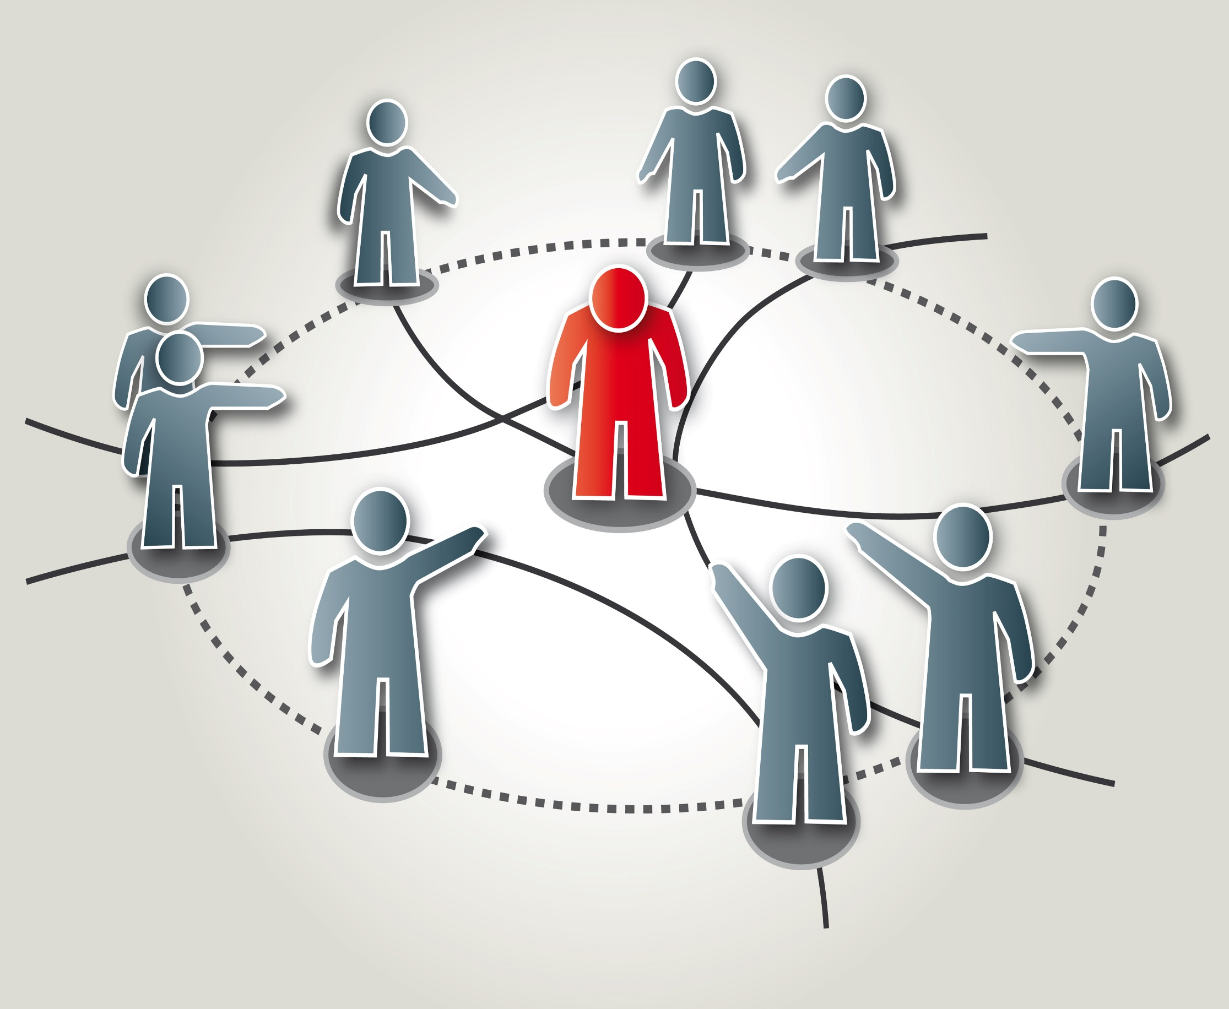
types of harassment
Notes:
just walk through the examples fairly quickly and highlight the less obvious ones with examples

Slide 10
discriminatory harassment
sexual harassment
harassment based on gender identity and gender expression
racial harassment
workplace bullying

Slide 11
verbal
verbally abusive behaviour such as screaming or yelling
insults and name calling
swearing and using offensive language
using a disrespectful tone of voice
mocking or mimicking someone

Slide 12
non-verbal
using disrespectful body language such as sneering, smirking or a cocky smile
staring or glaring
turning away from the target before he or she finished speaking
crossing arms aggressively
finger pointing

Slide 13
physical
slamming a hand down on the table
throwing temper tantrums
workplace pranks
tampering with someone’s work area or equipment

Slide 14
psychological
being dismissive
cyber bullying
gaslighting
character assassination
Jekyll and Hyde behaviour

Slide 15
group behaviour
turning others against the target
exclusion or ostracizing someone
gossip and nitpicking about someone

Slide 16
poisoned working environment
hostile, intolerable work environment
disrespectful behaviour that’s not targeted at an individual

Slide 17
why is there an epidemic of bad behaviour?

Slide 18
Notes:
- Emotional contagion

Slide 20
It started with this…

Slide 22
And also this…

Slide 24
sources of harassment

Slide 25
targets
public
managers
coworkers
council

Slide 26
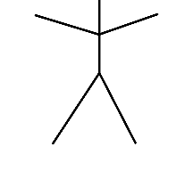
continuum of participation
Active
Supporters
Bully
Passive
Supporters
Active
Participants
Passive
Enablers
Active
Enablers
Notes:
BRAINSTORM:
Think of something that happened in the last month that was disrespectful. Where did you fit in on the continuum

Slide 27
impact of harassment

Slide 28
psychological harassment
effects minimized
can be more devastating and have longer-term effects than physical abuse
internalized victims work harder to fix the problem
Notes:
we grew up hearing “sticks and stones” but the truth is that names CAN hurt
Broadfield and DeHavilland Aircraft
damages were $1,000
Dental assistant called a dog by dentist
$500
recent sexual harassment cases have gotten as high as $250,000

Slide 29
organizational impact
legal liability
increased turnover
increased absenteeism/presenteeism
low morale
decreased productivity
difficulty recruiting employees
Notes:
we grew up hearing “sticks and stones” but the truth is that names CAN hurt
Broadfield and DeHavilland Aircraft
damages were $1,000
Dental assistant called a dog by dentist
$500
recent sexual harassment cases have gotten as high as $250,000

Slide 30
challenges in creating a respectful workplace

Slide 31
we all have different comfort zones
Notes:
The different life experiences and influences on our perception translate into different comfort zones.
Everyone’s is different and they can change over time.
just because someone may have a different/smaller comfort zone doesn’t make them “too sensitive” or “overly conservative” or “not fun”
For example, one person may find a sexual innuendo really funny when another person is indifferent or even uncomfortable (and this is not just on gender lines)
Discuss what to do when the group (thinks) they all have the same comfort zone and someone with a smaller comfort zone is part of the group – do they have to adapt to that person, does that person have to accept the culture or is it a combination.
I often discuss the DeHavilland and Christine Broadfield case on this (summary and case attached). DeHavilland argued culture of the workplace. Did not succeed.

Slide 32
the reality gap
Notes:
We think other people hear, see and feel the same things we do
Projective Cognitive Similarity:
assuming that others think, feel and reason in the same way that we do

Slide 33
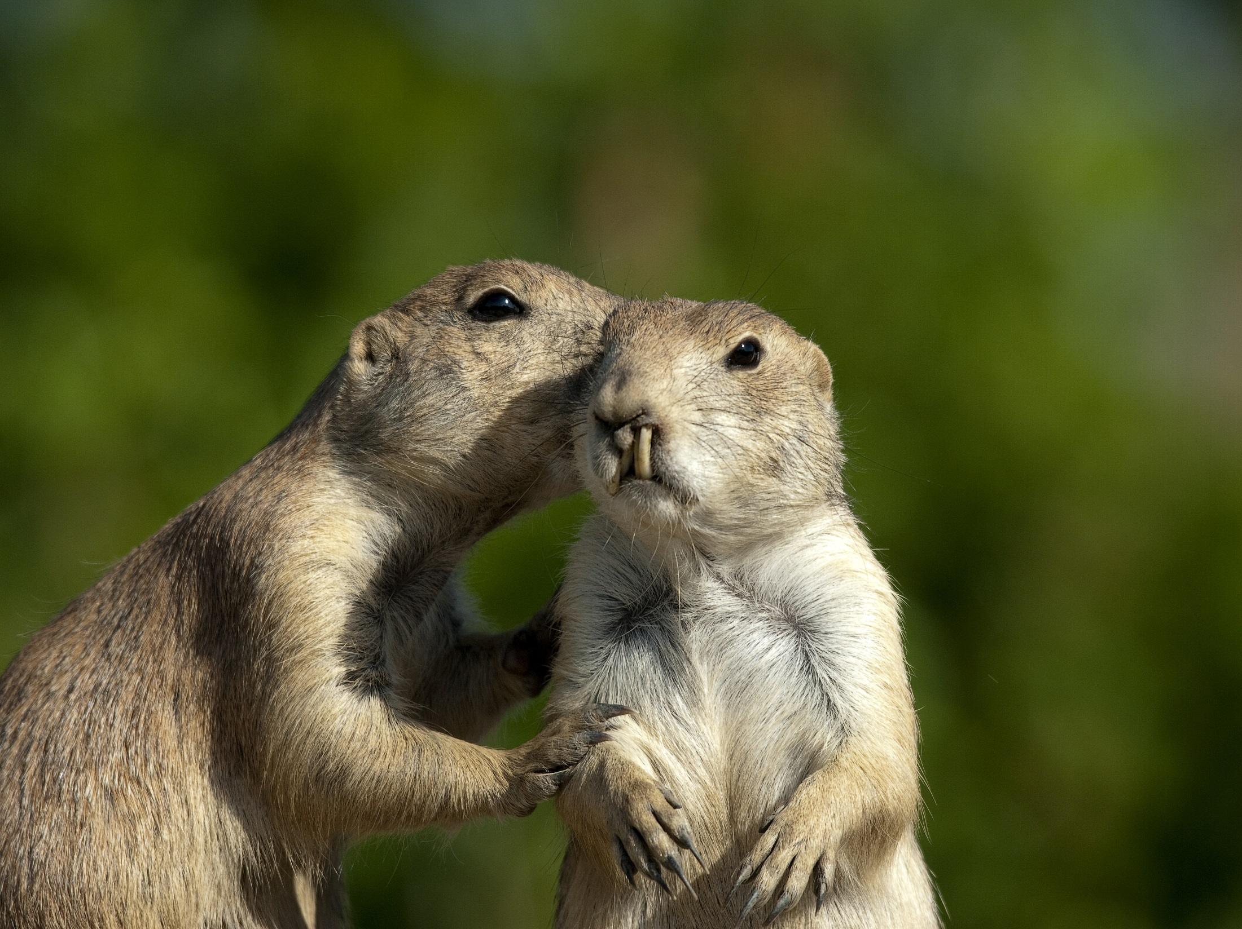
gossip
Notes:
Gossip is like slitting open a feather pillow on a rooftop and telling someone to go pick up the feathers
Marni’s remedy for gossip is to say to the person – let’s go together to talk to them about that. It generally shuts things down.
Another technique is to say, “why would you say a thing like that?”

Slide 34
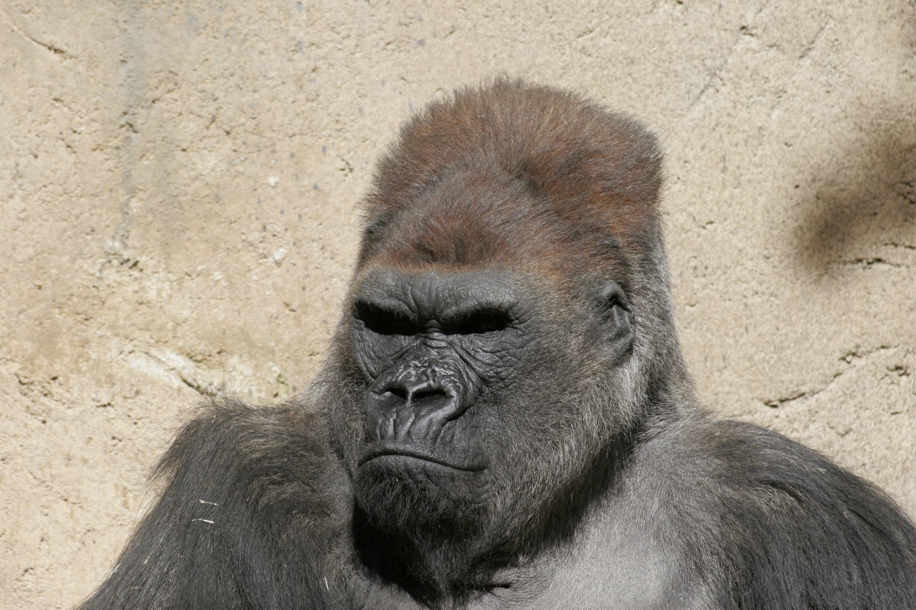
negativity
Notes:
one negative person can suck the life out of everyone around them
emotions are contagious – it’s called emotional contagion
negative emotions are more contagious than positive ones
Here is a good analogy I found online:
How much do emotions matter in the workplace? Walk into any Department of Motor Vehicles and you’ll feel the impact of the prevailing mood instantly — a dense fog of sourness, irritability, and listlessness.
Walk into almost any Apple store and you’ll experience the opposite — a sense of aliveness and excitement that raises your energy (and makes you want to buy something).
use the “But technique” to counter negativity – if someone says something negative, counter it with a positive. For example, if someone says the supervisor is curt you could say BUT…I know she is very busy and when I meet with her for feedback she is really helpful
also talk about “what went right” instead of focusing on what went wrong

Slide 35
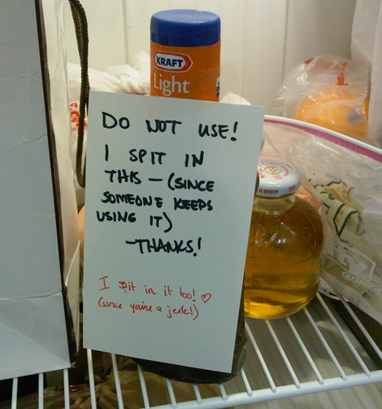
passive aggression
Notes:
Examples:
“just kidding” – pretending you didn’t know something would upset someone
constant procrastination
showing up late for meetings all the time
not speaking up during a discussion and then complaining about the outcome
doing a deliberately bad job

Slide 36
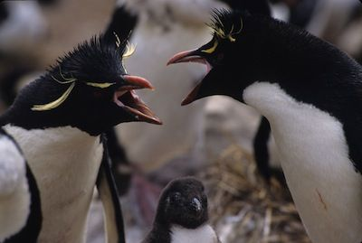
unresolved conflict
Notes:
speak directly to the person
listen and be present
own your contribution
agree on a resolution

Slide 37
attribution error
(assuming the worst)

Slide 38
Notes:
BRAINSTORM
what is this woman thinking?
is she thinking “that person must be in a hurry, I bet they have something really important they need to do”?

Slide 39
confirmation bias
(we look for evidence to support our pre-existing beliefs)

Slide 40
creating a positive workplace

Slide 41
policies
Respect in the Workplace
Code of Conduct (council and staff)
positive workplace
Notes:
LB
-Ongoing training
-council/staff relations
-conflict resolution
-interpersonal effectiveness
-communication skills
-debating skills

Slide 42
education
council and staff
respectful engagement
conflict resolution
communication skills
Notes:
LB
-Ongoing training
-council/staff relations
-conflict resolution
-interpersonal effectiveness
-communication skills
-debating skills

Slide 43
address dysfunctional teams
identify the troublemakers
encourage bystander interventions
make sure managers manage
create a team charter
Notes:
LB
-Ongoing training
-council/staff relations
-conflict resolution
-interpersonal effectiveness
-communication skills
-debating skills

Slide 44
act on complaints immediately
investigation
internal vs. external
mediation
only if it is between equal parties
Notes:
LB
-Ongoing training
-council/staff relations
-conflict resolution
-interpersonal effectiveness
-communication skills
-debating skills

Slide 45
don’t
sweat
the
small
stuff!

Slide 46
The only person you can change is yourself
Be the change

Slide 47
Video: Unsung Hero
Notes:
Tell them to look past him giving the dog a chicken bone (dangerous to dogs)
No matter how small – we can all make a difference

Slide 48
questions
positive and respectful workplaces

